Slide 1

Temporal Uber Traffic Fluctuations New York City Case Study
Contributors:
Jane Lee | Lillian Zhao | Prof. Manning
Notes:
Prepare some pdf, Powerpoint, Keynote, or Google slides where you motivate your question and dataset (e.g. why is it interesting?), paste in some figures from your Jupyter notebook, and use them to tell a story about what you found.

Slide 2

Motivation:
Individual-level behavior => Macro Changes
(Individuals Visualized & Temporal Trends)
Phase-out of government run v. private sector transportation (taxi, subway, uber)
Adoption of autonomous vehicles
Tech savvy adoption
General transportation structures
Measured by volume of riders
Load bearing on transport system, city grid, etc.

Slide 3
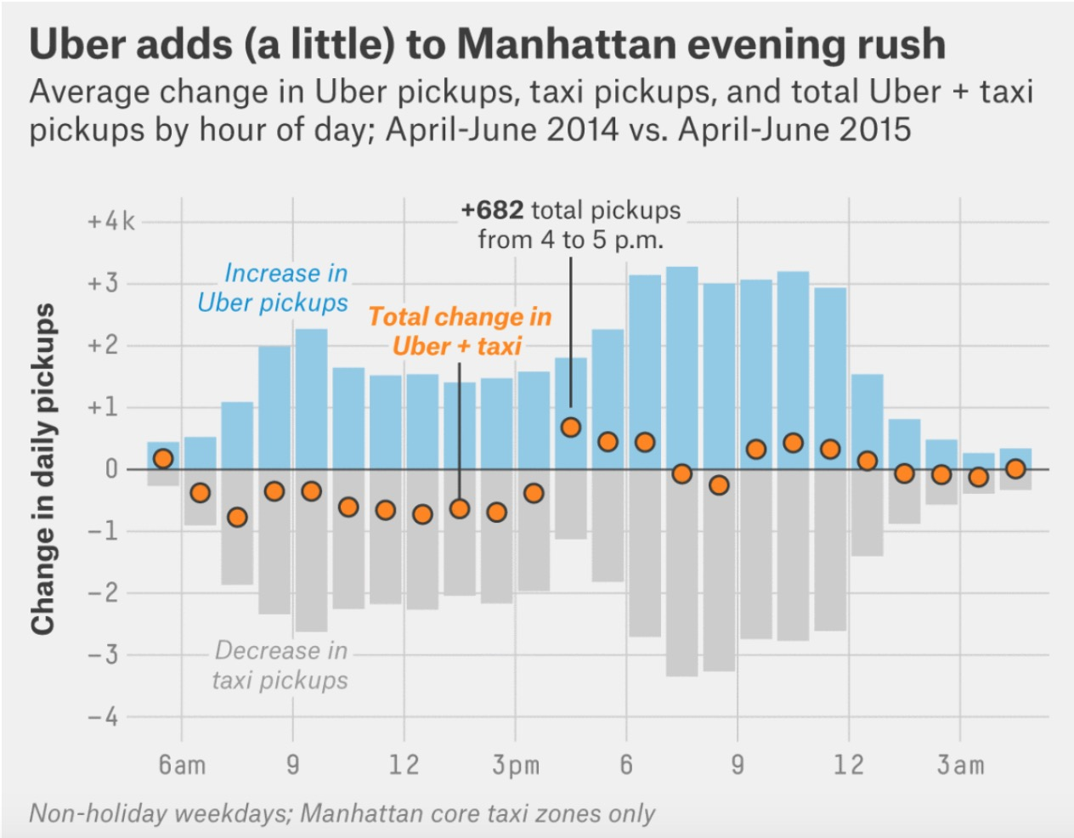
Motivation:
FiveThirtyEight analysis of NYC Uber data insights:
Uber adds (a little) to Manhattan evening rush traffic
Thousands of pickups outside of Manhattans core
Unanswered questions inspired by this analysis:
How does Uber usage compare on the weekend?
How do seasonal changes affect rush hour traffic and daily temporal fluctuation?
What does this movement *look* like?

Slide 4
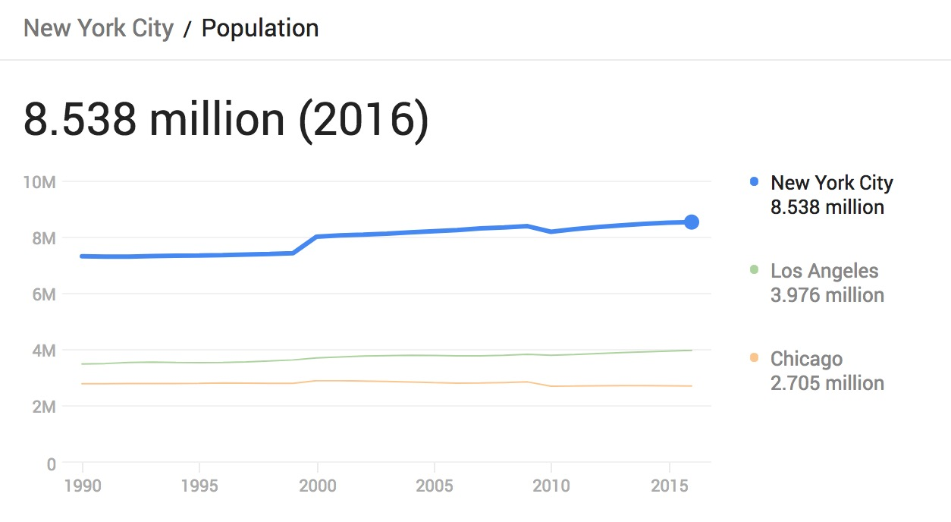
Data Considerations
Considerations in the design of our findings:
NYC is highly populated, dense, and has developed public transport/taxi industry
Well-established Uber and Lyft usage

Slide 5
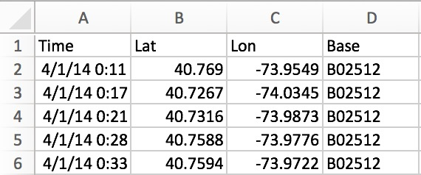
Data Set:
Uber Trips Data
All NYC Uber Trips: April 2014 through June 2015, provided in .csv by month
Each file contained: Date/Time, Pickup Latitude, Pickup Longitude, Base (Driver)
FiveThirtyEight submitted Freedom of Information request to [NYC Taxi & Limousine Commission (TLC)]
Hence severe limitations on the length of Uber data available, as well as location

Slide 6
Weekly Traffic Fluctuation

Slide 7
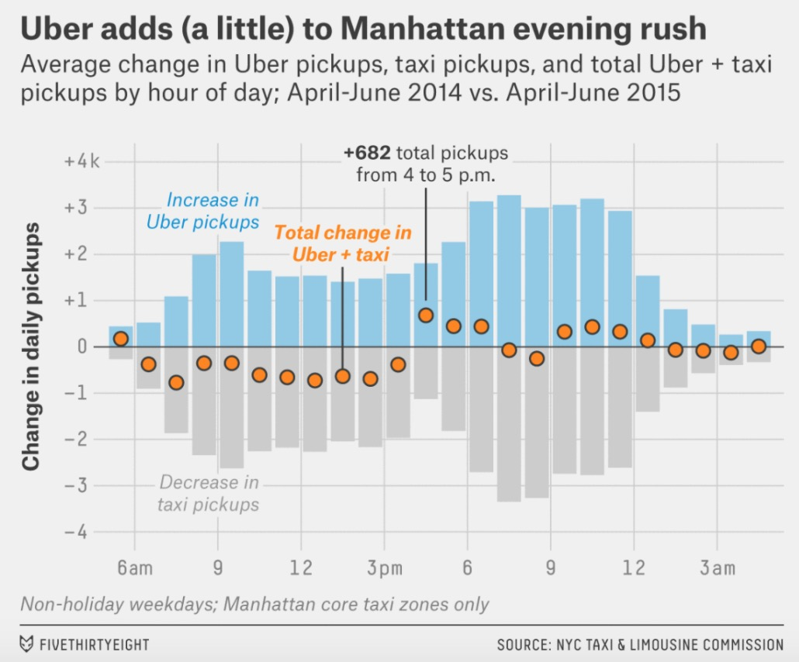

Slide 8
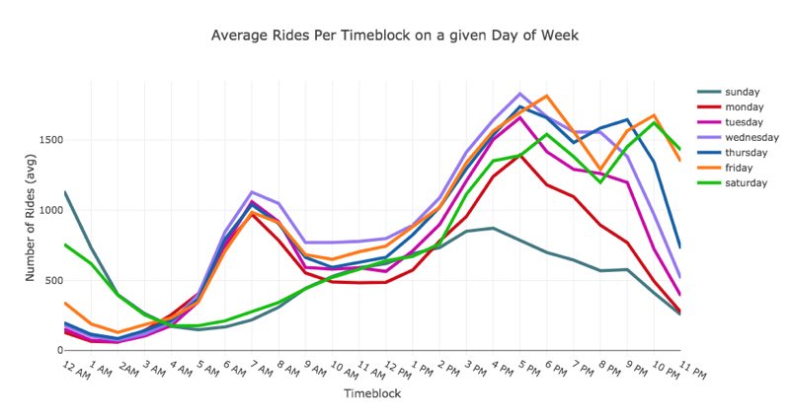
Uber Rides Volume over Time of Day by Weekday
Notes:
3 types of behaviors

Slide 9
Uber Rides Volume over Time of Day (by Day of Week)
Friday & Saturday:
Going out nights
Work Week Model
A diverging weekend
Notes:
3 types of behaviors
- A diverging weekend

Slide 10
Uber Rides Volume over Time of Day by Weekday
Culminating in Thursday
Uniform weekday mornings
Rise in nighttime pattern volume over weekdays
Notes:
3 types of behaviors
- A diverging weekend

Slide 11
Seasonal Traffic Fluctuation

Slide 12
Individual Dot Visualization of Rides throughout Day: Spring Season

Slide 13
Individual Dot Visualization of Rides throughout Day: Summer Season

Slide 14
Individual Dot Visualization of Rides throughout Day: Fall Season

Slide 15
Individual Rides Dot Visualization: Takeaways
Summer sees higher trips volumes & more movement outside of Manhattan core
2 possible hypotheses include:
Weather effects of a colder spring/fall reduce late night going out (and ergo Uber usage)
Winter limitation: dataset did not provide juxtaposition of winter to affirm this theory
Summer tourism (60.3 M tourists every year)
Notes:
Is September an exception?

Slide 16
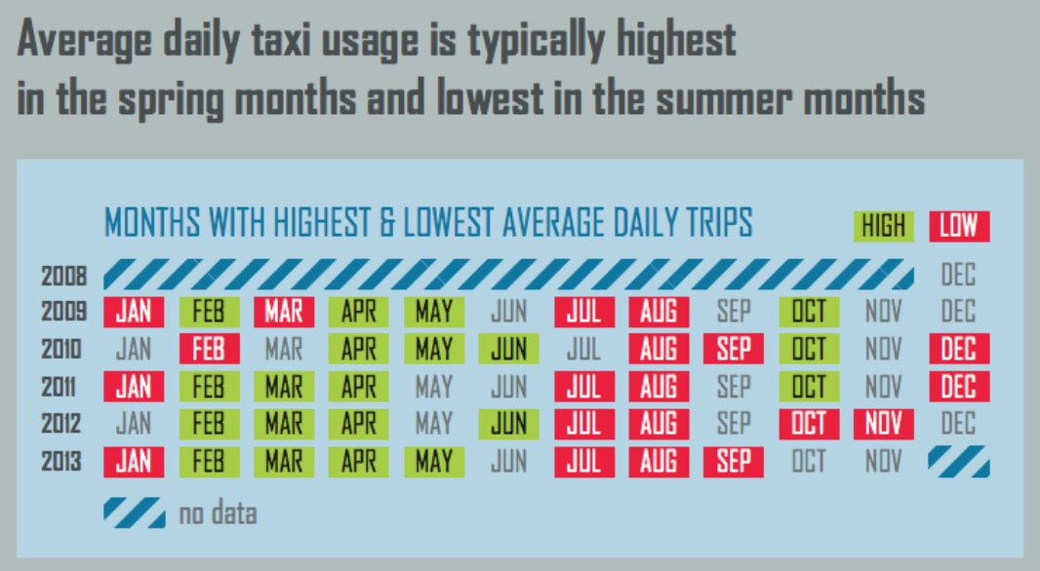
Theoretical Contradiction for Month-to-Month Fluctuation
NYC Government Taxi Cab Factbook

Slide 17
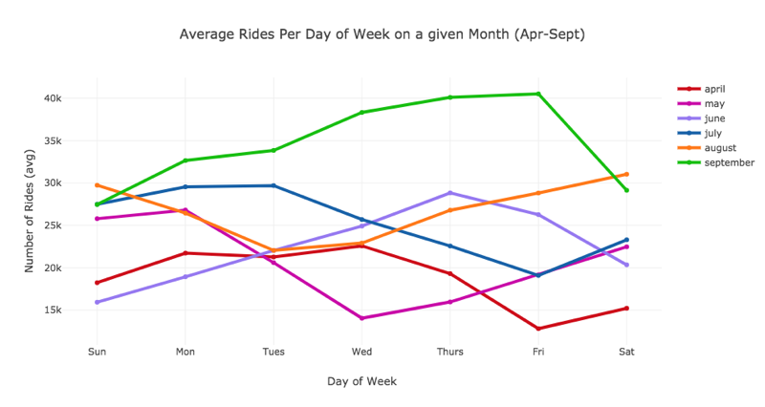
Month-to-Month Fluctuation of Day of Week Ride Volumes
High Sept. usage

Slide 18
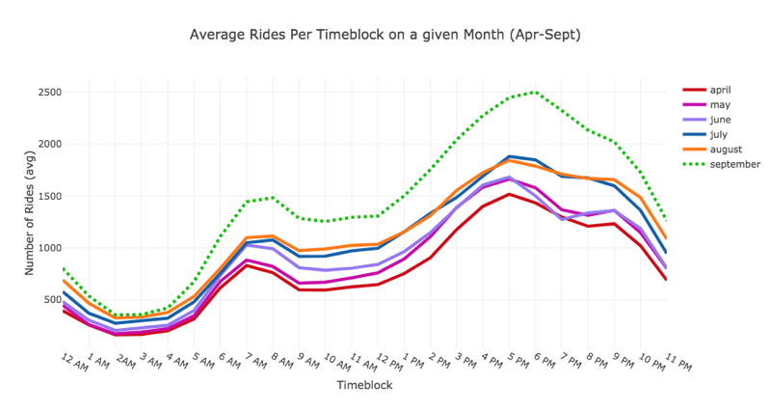
Uber Rides Volume: Daily Temporal Fluctuation (by month)
High Sept. usage
Consistent Month-to-Month Pattern

Slide 19
Weekday patterns differ by month, but time of day patterns average out to a consistent behavior.
High Sept. usage
Possible counter-theory:
Uber’s rising popularity accounts for discrepancy in historical taxi monthly traffic patterns.
Consistent Month-to-Month Pattern

Slide 20
Conclusions

Slide 21
Conclusion
Individual-Level daily traffic fluctuation is very consistent with expected behaviors
Seasonal traffic data defies historical taxi cab information
Macro implications:
Phase-out of government run v. private sector transportation (taxi, subway, Uber)
Adoption of ride-sharing and tech savvy options
Load bearing on transport system, city grid
Uber individual visualization mirrors what we might expect with out of Manhattan core movement

